Slide 1
Nutrition Agent
CAPSTONE PROJECT
Presented By:
Student name : Tanushree Ray
College Name & Department :
Kalinga Institute of Industrial Technology, B.Tech CSE

Slide 2
OUTLINE
Problem Statement
Technology used
IBM Cloud Services used
Wow factors
End users
Results
Conclusion
Github Link
Future scope
IBM Certifications

Slide 3
Problem Statement
In today’s fast-paced world, individuals are increasingly seeking personalized nutrition guidance tailored to their unique health goals, medical conditions, dietary preferences, and lifestyle habits. However, most existing solutions offer generic diet plans and lack real-time adaptability, cultural sensitivity, and holistic personalization. This creates a gap between user expectations and the limited capabilities of one-size-fits-all nutrition tools.
Proposed Solution:
An AI-powered Nutrition Agent that leverages Natural Language Processing (NLP) and Retrieval-Augmented Generation (RAG) to deliver personalized meal plans, smart food substitutions, nutritional explanations, and dietary recommendations. The agent can adapt in real-time to user feedback, support text or voice input, and provide actionable, context-aware dietary insights—empowering users to make healthier food choices sustainably.

Slide 4
Technology used
IBM cloud lite services
Natural Language Processing (NLP)
Retrieval Augmented Generation (RAG)
IBM Granite model

Slide 5
IBM cloud services used
IBM Cloud Watsonx AI Studio
IBM Cloud Watsonx AI runtime
IBM Cloud Agent Lab
IBM Granite foundation model

Slide 6
Wow factors
This agent will revolutionize how individuals approach nutrition by delivering personalized, adaptive, and intelligent meal planning. It reduces reliance on generic diet plans, supports real-time customization, and bridges the gap between lifestyle, health, and food choices. It empowers users to make informed dietary decisions with ease, accessibility, and accuracy.
Unique Features:
Dynamic meal plan generation based on health goals, dietary preferences, allergies, and cultural habits
Smart food substitution engine to suggest healthier or preferred alternatives in real-time
Contextual nutritional explanations like “Why is quinoa better than white rice for your goal?”
Multimodal input support – understands user inputs via text, voice, or food label/photo
Feedback-driven adaptability – learns from user preferences and updates future suggestions
Localized and culturally relevant food recommendations for enhanced personalization
Goal-based guidance – supports weight loss, muscle gain, diabetic-friendly, heart-healthy diets, etc.

Slide 7
End users
Health-Conscious Individuals - Looking for personalized and sustainable diet guidance.
Fitness Enthusiasts & Athletes - Seeking optimized meal plans aligned with workout goals.
Dieticians and Nutritionists - As a support tool for client engagement and scalable consultations.
Healthcare Providers - For patient dietary recommendations in chronic disease management.
Educational Institutions - Teaching tools in health sciences, nutrition, and wellness programs.
Wellness Coaches & Lifestyle Consultants - Enhancing personalized care with AI-driven insights.
Public Health Organizations - Promoting preventive health and nutritional literacy at scale.

Slide 8
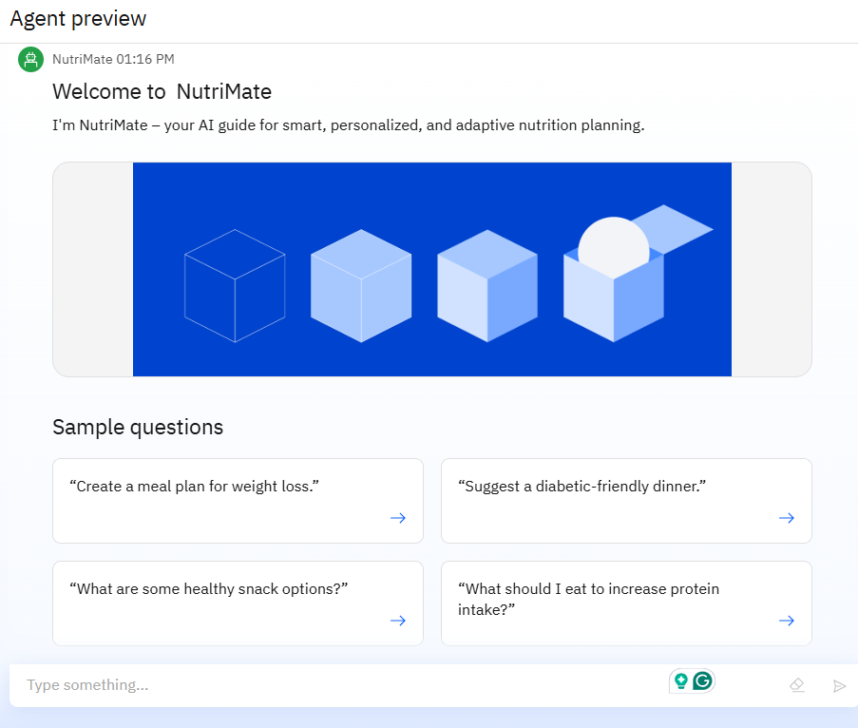
Results

Slide 9
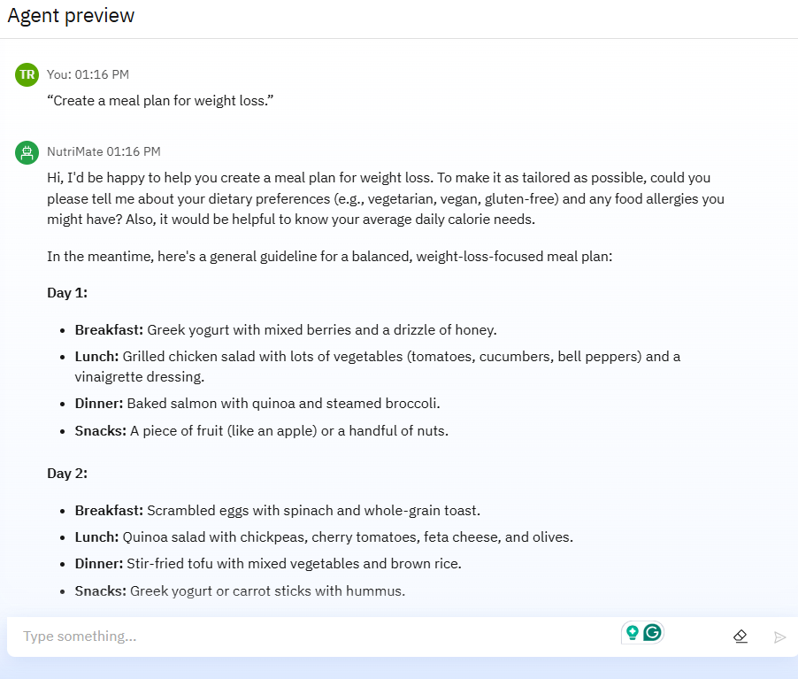
Results

Slide 10
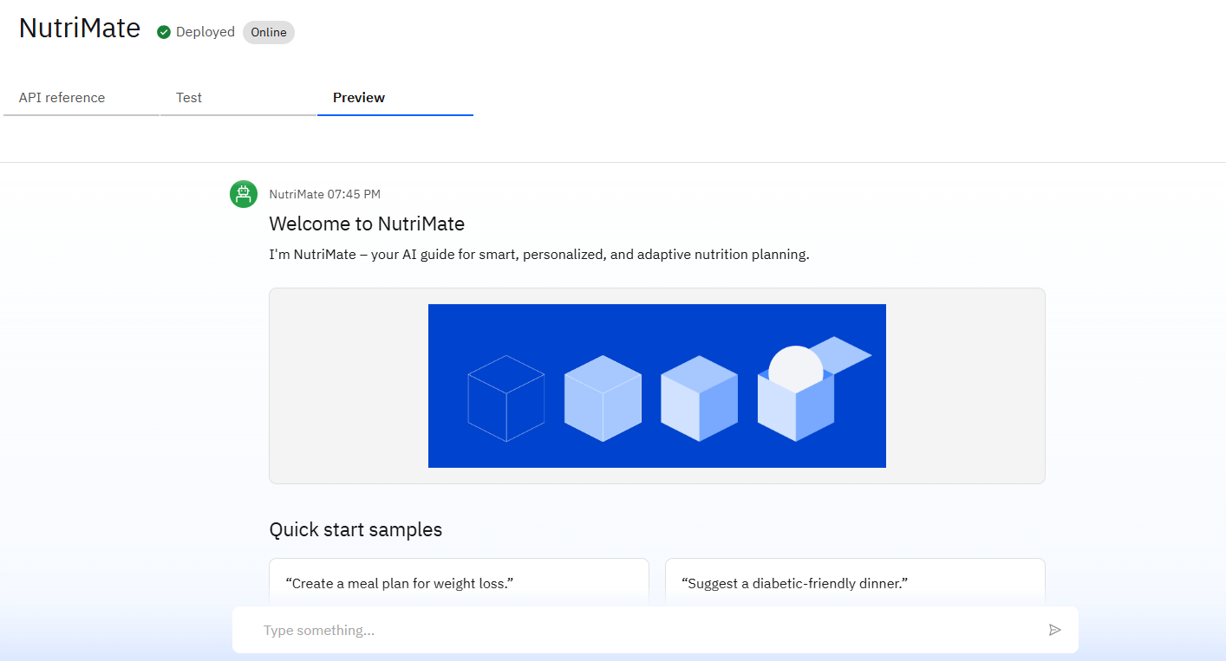
Results
Deployed AI Agent

Slide 11
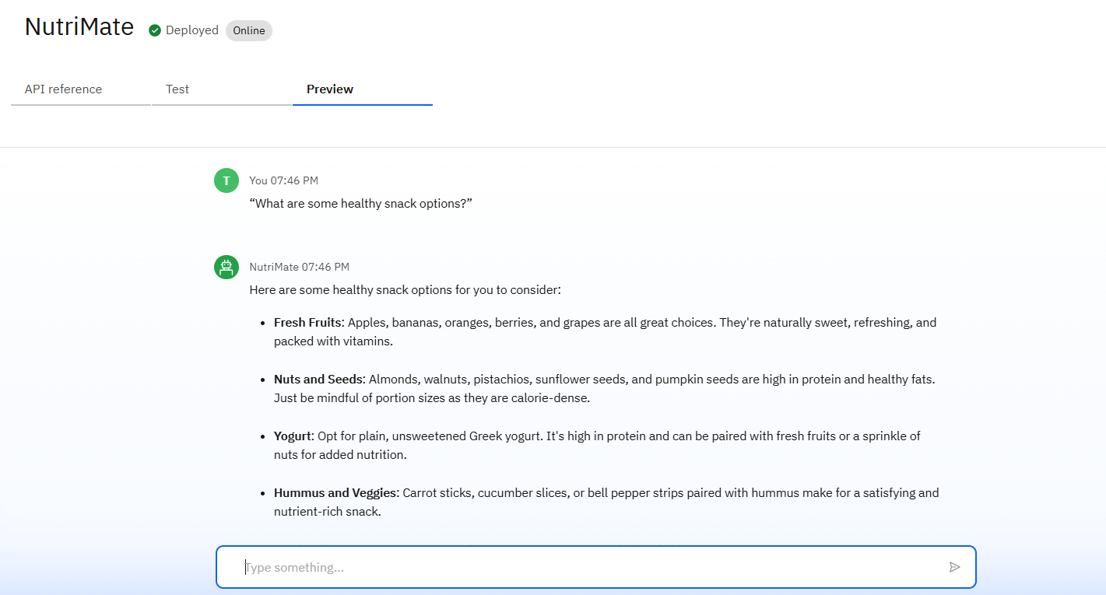
Results
Deployed AI Agent

Slide 12
Conclusion
The agent can generate personalized meal plans, suggest healthier food alternatives, and provide contextual nutritional guidance tailored to individual needs.
It saves time by automating routine tasks like dietary planning, nutrient analysis, and food substitution.
The Nutrition Agent enhances health awareness, supports goal-based eating, and brings personalization, consistency, and intelligence to everyday nutrition decisions.

Slide 13
GitHub Link
Github Link - https://github.com/tanushree-ray/IBM-SkillsBuild_Nutrition-Agent

Slide 14
Future scope
Multilingual Nutrition Guidance - Support for regional languages to improve accessibility and inclusivity.
Voice-Activated Meal Planning Assistant - Hands-free interaction for quick dietary queries and suggestions.
Integration with Health Wearables and Apps - Use real-time health data (e.g., steps, vitals) to fine-tune diet plans.
Cultural and Regional Cuisine Personalization - Tailor meal suggestions based on local ingredients and traditional diets.
AI-Powered Grocery List and Meal Prep Scheduler - Automatically generate shopping lists and prep plans based on meal suggestions.
Health Goal Tracking and Adaptive Recommendations - Adjust plans dynamically based on user progress, feedback, or lifestyle changes.
Nutrition Education and Awareness Modules - In-app learning content for schools, communities, and public health campaigns.

Slide 15
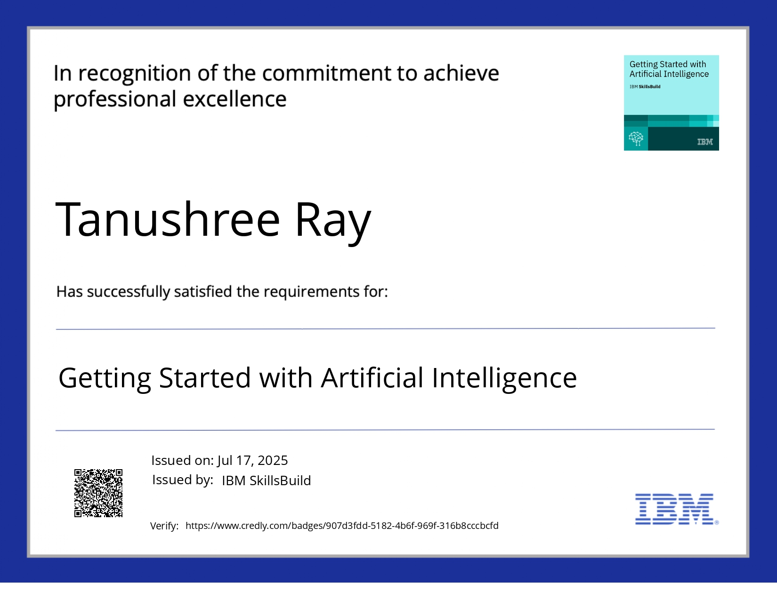
IBM Certifications
Getting Started with Artificial Intelligence

Slide 16
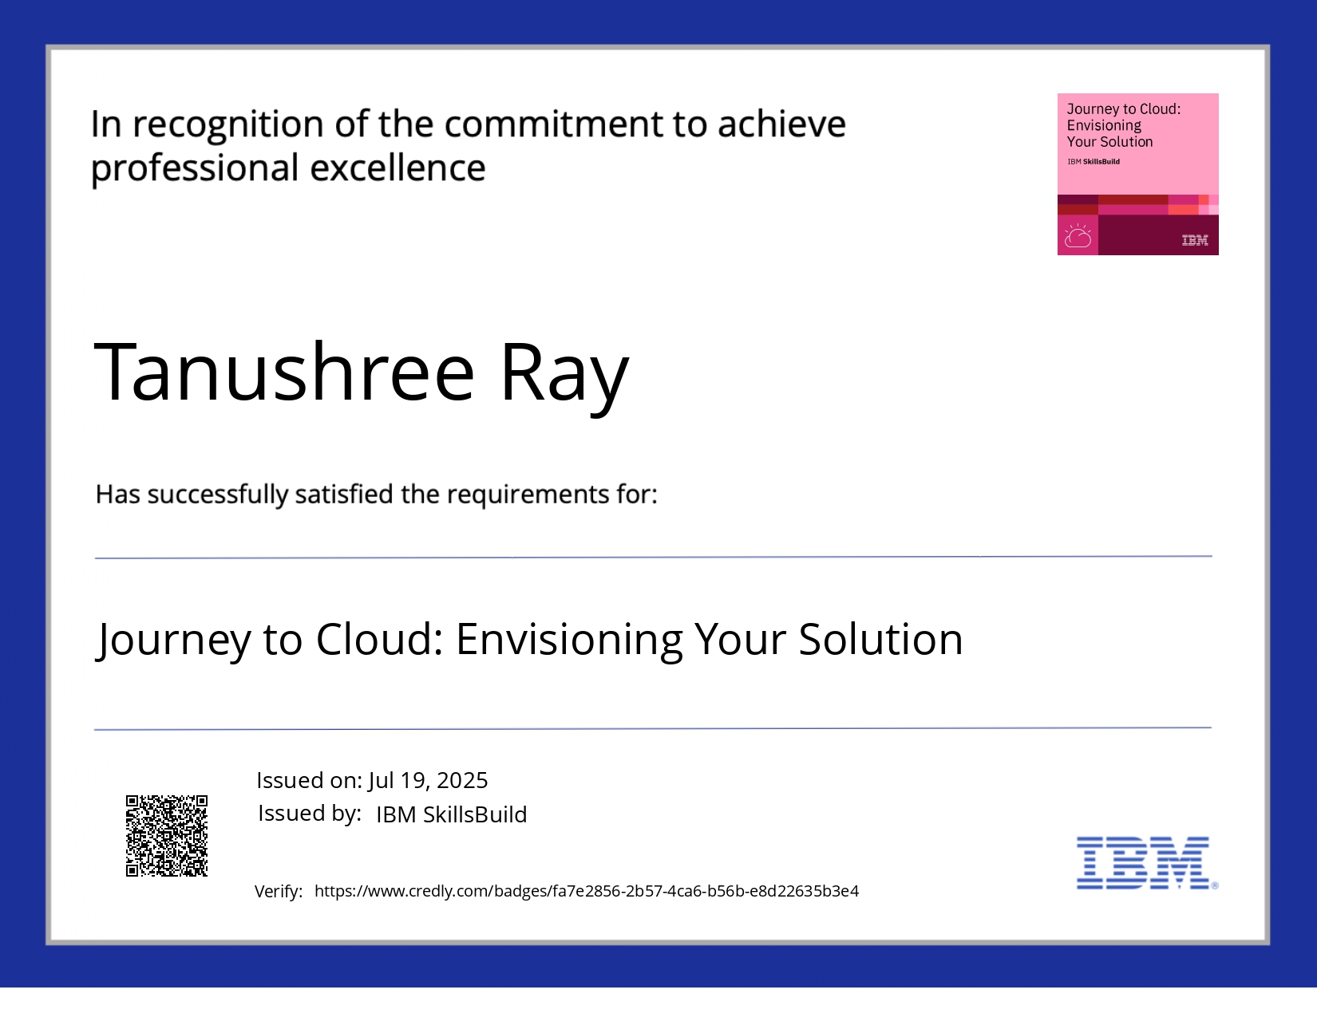
IBM Certifications
Journey to Cloud

Slide 17
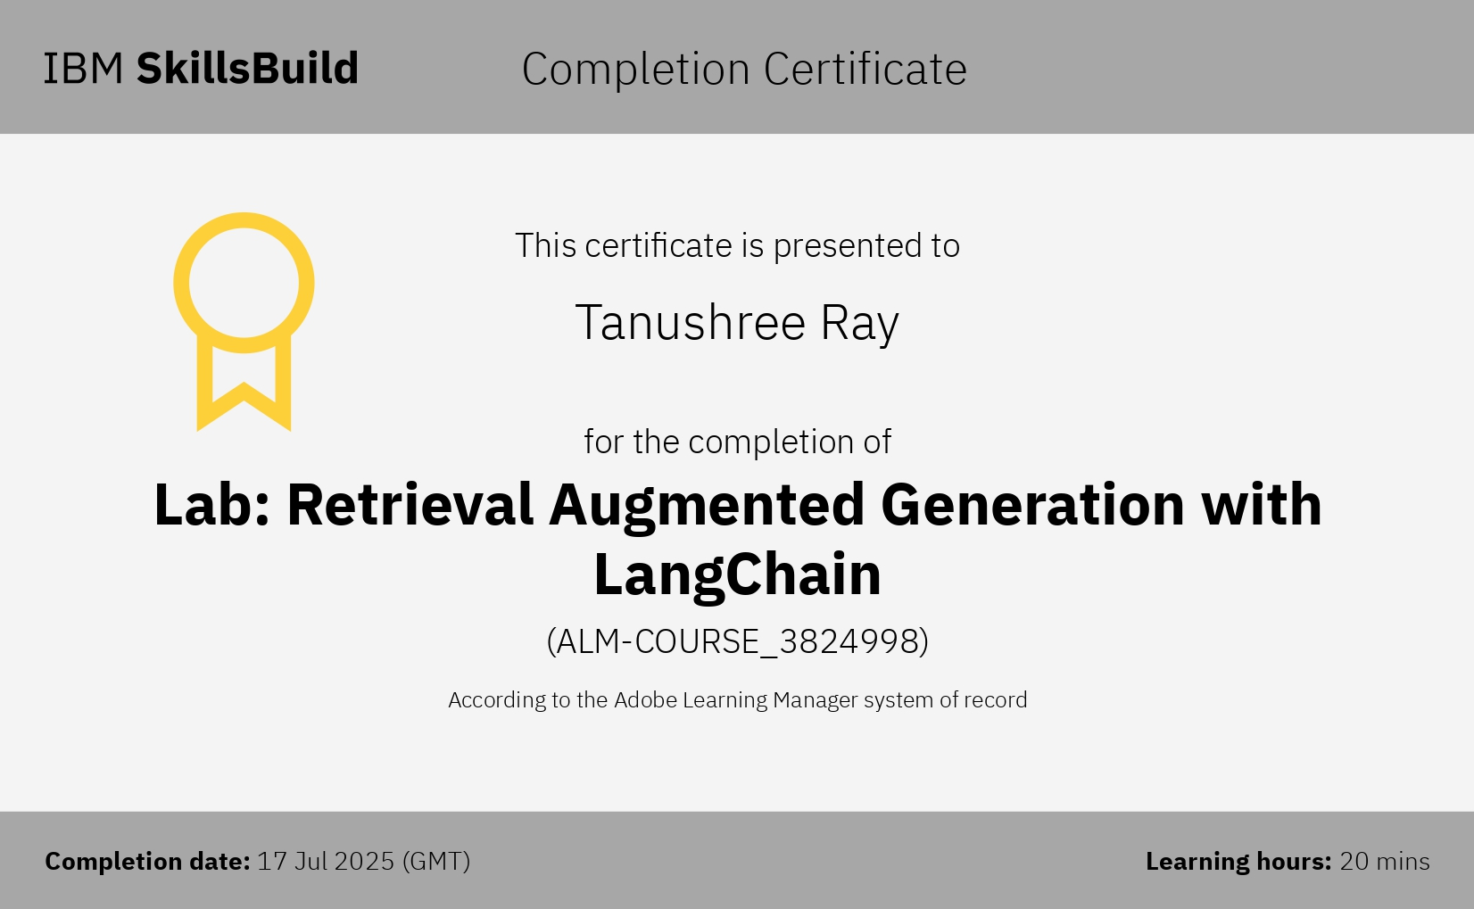
IBM Certifications
RAG Lab

Slide 18
THANK YOU

